Slide 1
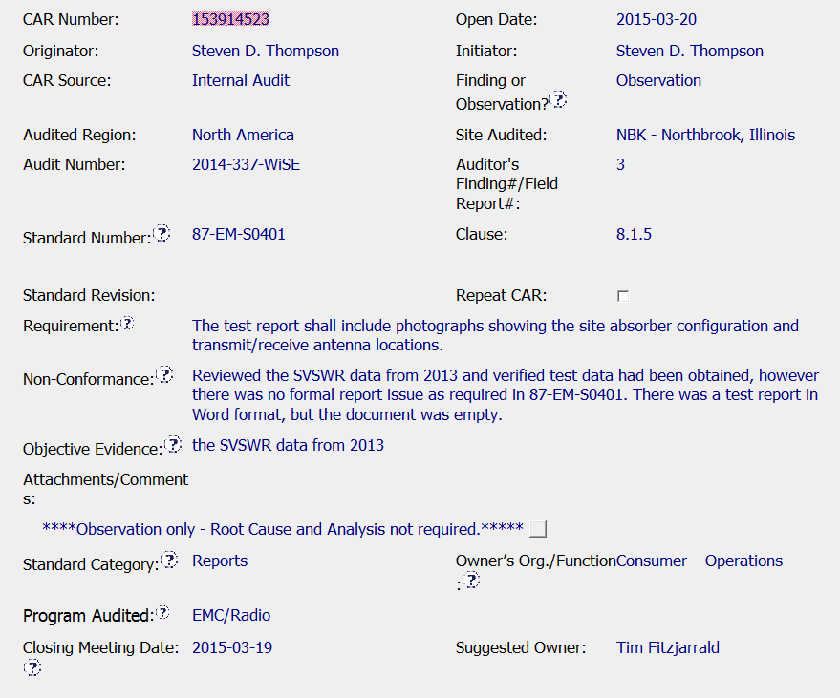

CAR 153914523 - Observation
Includes a specific clause for the requirement along with specific details about the non-conformance
Was there only one set of data for the year? Are there other sets that could have been incorrectly uploaded?

Slide 2
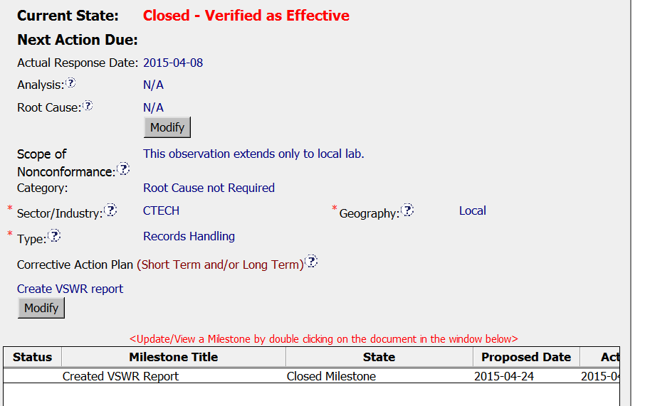
CAR 153914523 - Observation
Analysis, RC, and Scope not required
Correct category for OBS
Sector, type and geography
CAP corrects the issue with an associated milestone

Slide 3
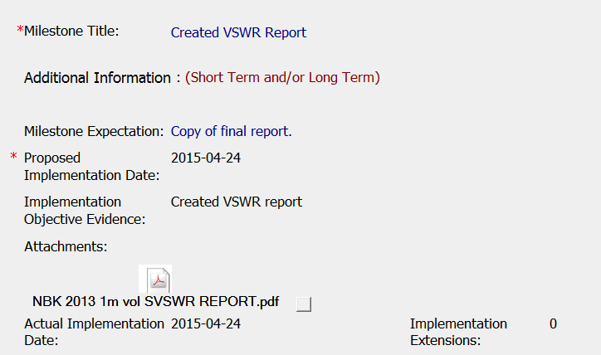
CAR 153914523 - Milestone
Milestone evidence includes the missing record
Suggestion:
Include a screen shot showing storage location of record

Slide 4
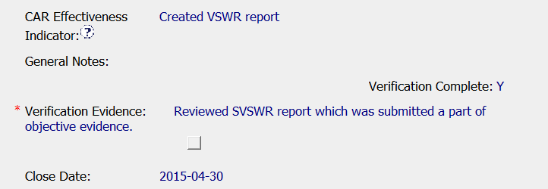

CAR 153914523 – Verification
Observation CAR closed and verified effective immediately

